Slide 1
WordPress - introduction (Day 3)
Viktoras Lava www.viktoraslava.lt

Slide 2

What is WordPress?
WordPress is the most popular content management system in the world between simple users, businesses and ofcourse hackers.
It runs on top of Apache web server, that has PHP and MySQL.

Slide 3
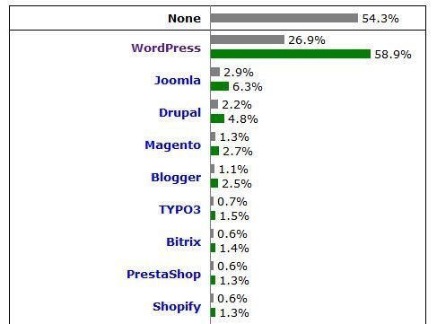
Statistics
Over 26.9 % of websites on the web now use WordPress. That’s more than one billion websites!
There are 72 translations of WordPress, 47,000 plugins and unkown amount of themes.

Slide 4
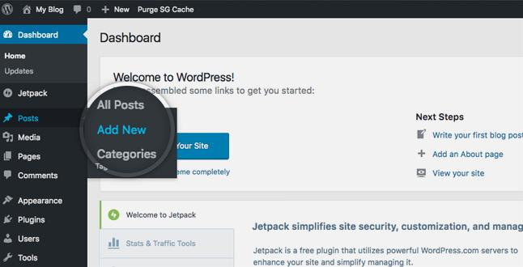
Reasons
The main factor why WordPress is so popular right now, because nothing managed to beat it in the user experience race.
Even though it’s not the most user-friendly CMS, right now, it was probably the first one that started to focus on user-experience in a very early development stage.

Slide 5

Server requirements
In order to launch WordPress you need to make sure that your server meets the requirements.
PHP 7.2 or greater
MySQL 5.6 or greater or MariaDB 10.0 or greater
Nginx or Apache with mod_rewrite
HTTPS support

Slide 6

Installing WordPress locally
To install WP on your local machine you need to have a local or remote server.
The easiest way to launch a local server is through web development environments.
For Windows use WAMP
For MacOS use MAMP
For Linux use AMPSS

Slide 7
Setting up WordPress
The easiest way to setup WP is by following guides on the internet as the process is not very straight forward.
Guides for :
WAMP
MAMP
AMPSS

Slide 8
Questions?

